Slide 1
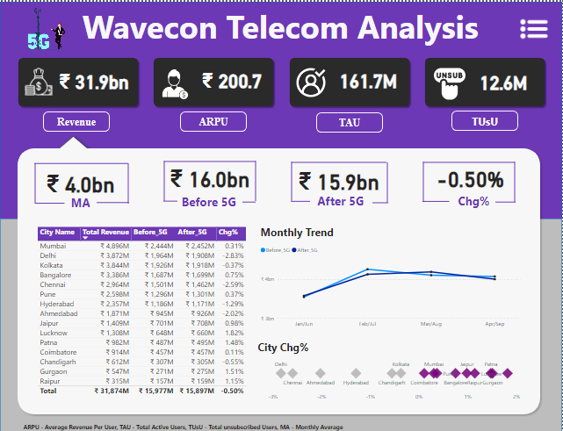
Wavecon Telecom Analysis Dashboard
The Wavecon Telecom Analysis dashboard provides an overview of key performance metrics for Wavecon Telecom, focusing on the impact of 5G on revenue and user engagement. Key metrics are displayed at the top
Total Revenue
ARPU (Average Revenue Per User)
TAU (Total Active Users)
TUsU (Total Unsubscribed Users)
Revenue (MA)
Revenue (Before 5G)
Revenue (After 5G)
Change in Revenue (Chg%)

Slide 2
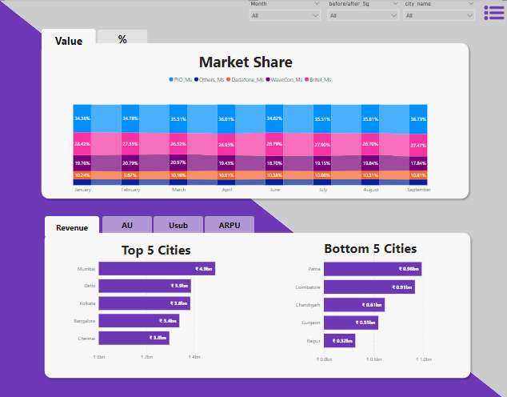
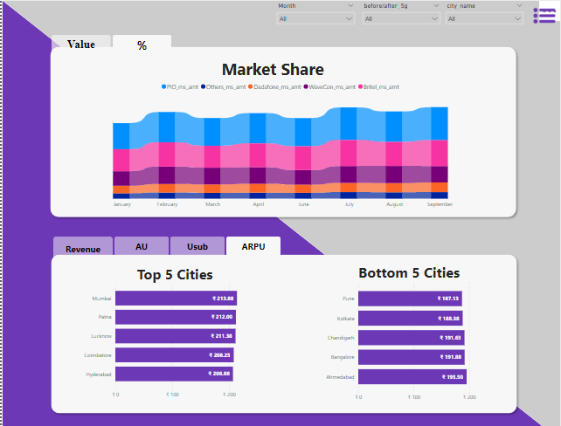
Market share & market share %

Slide 3
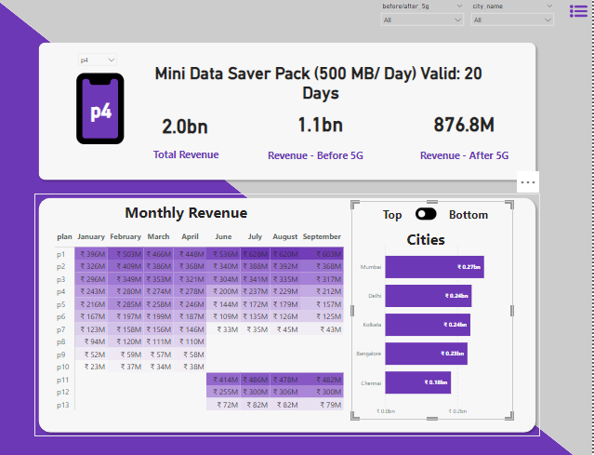
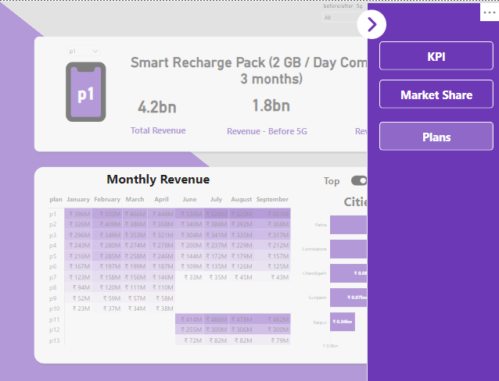
Data saver Pack revenue(500mb/day)

